Slide 1


One channel EEG sleep staging with open source and open hardware NeuroOn sleep mask
Franciszek Rakowski, PhD
&
Paweł Kazimierzewski

Slide 2
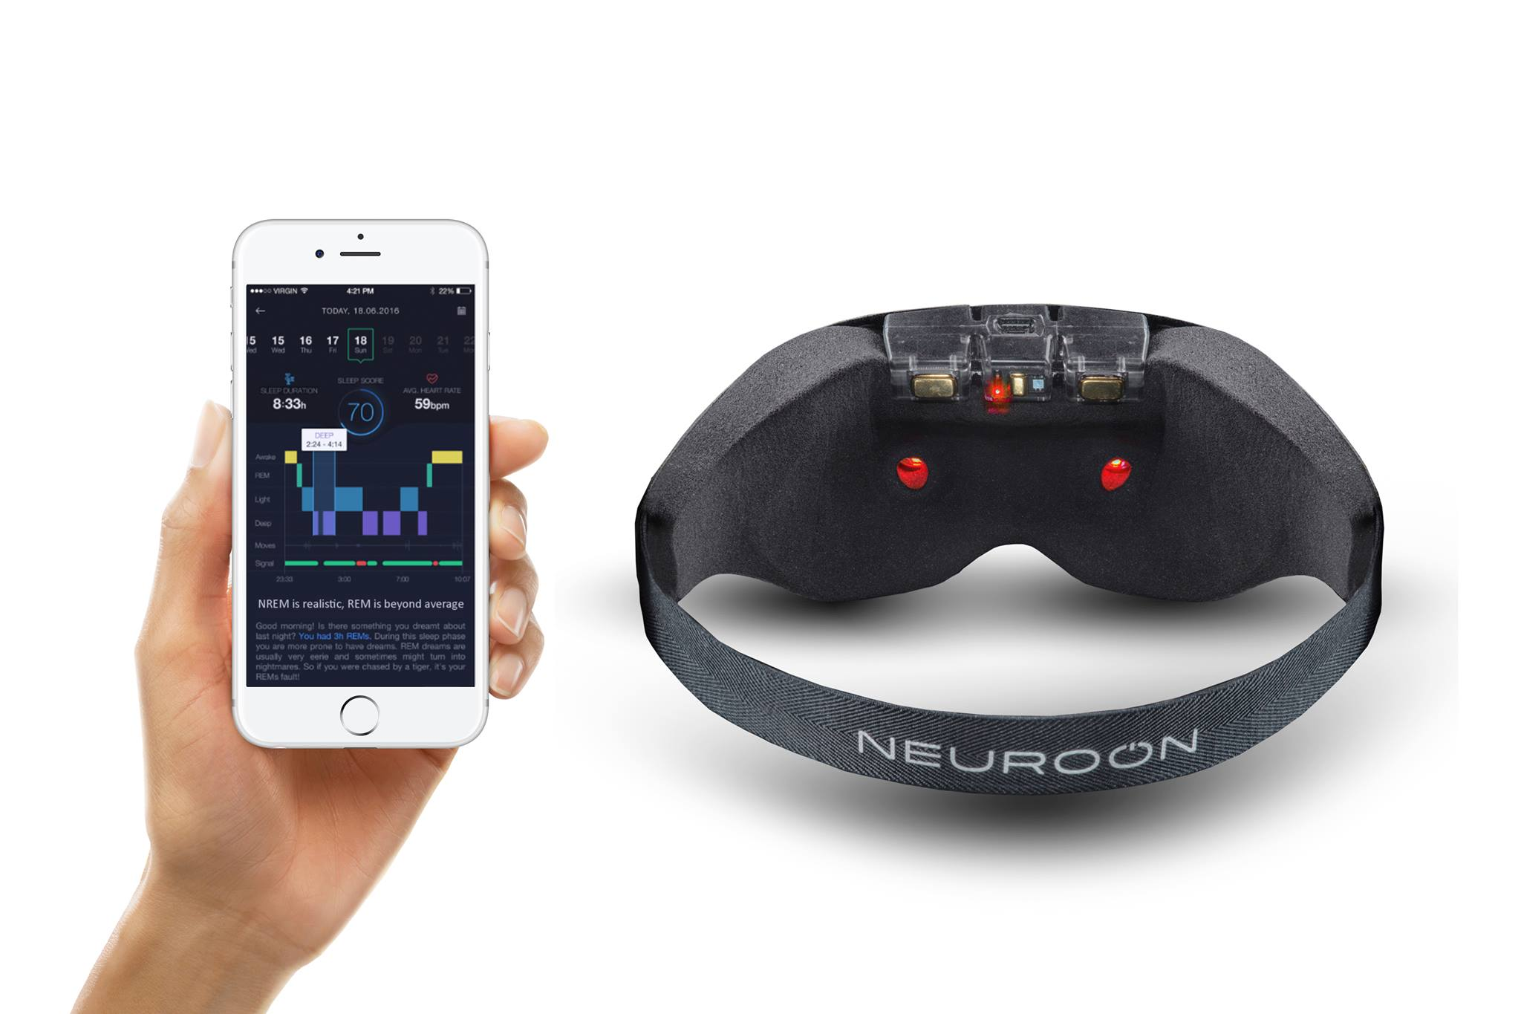
Neuroon SleepMask
One channel EEG
Pulse – Oximeter
Accelerometer
Temperature
Effectors
Mobile Application

Slide 3
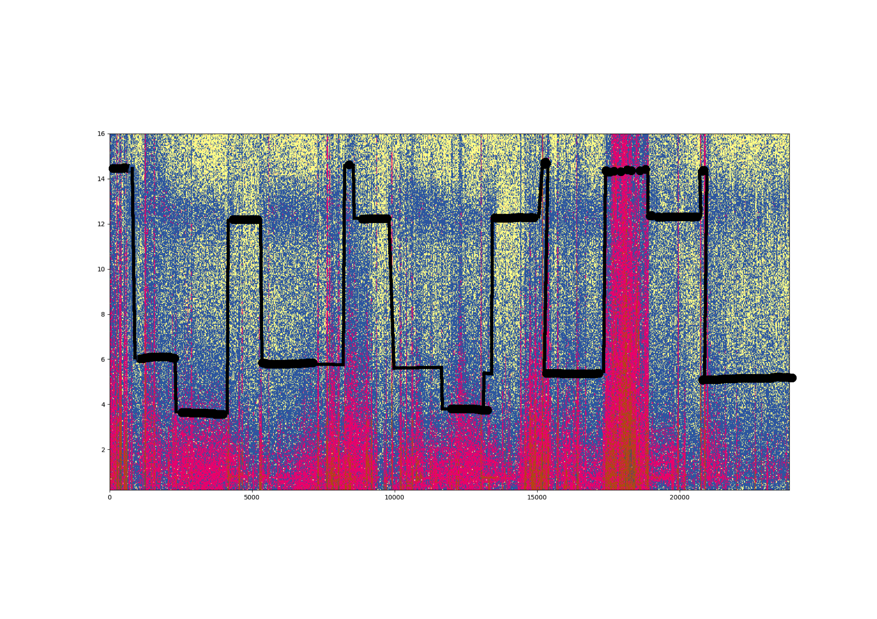
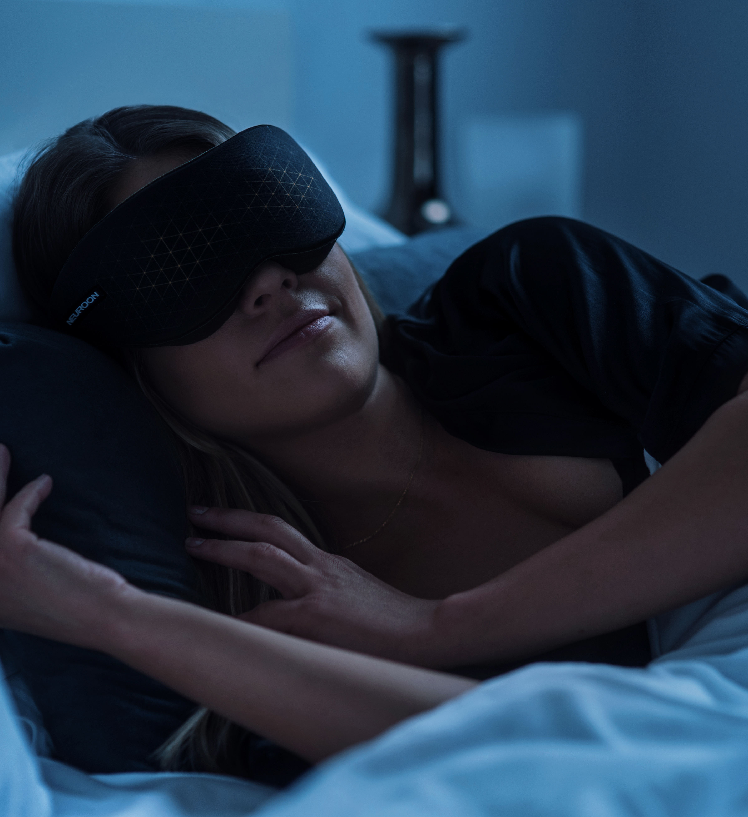
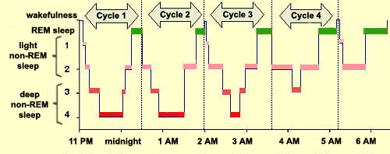
SleeP Staging with Neuroon
Machine Learning

Slide 4
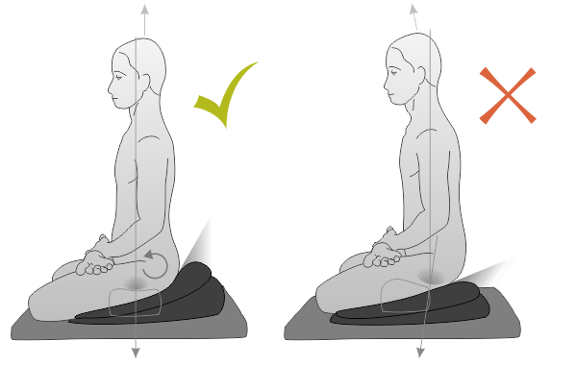
The Neuroon meditation experiment
Block 1 (10’):
- sitting
- eyes open
- no particular task
Block 2 (10’):
- sitting
- eyes closed
- no particular task
Block 3 (10’):
- sitting
- eyes closed
- attention focused on breath
Position & environment control:
Environment low but not devoid of visual & auditory stimuli
Ideally same environment for each participant
The participant should not be interrupted during data gathering
There should be min. 10 minute pause of free walking & interacting with others between each block
Each participant should perform three blocks with a total of at least 30 minutes

